Slide 1

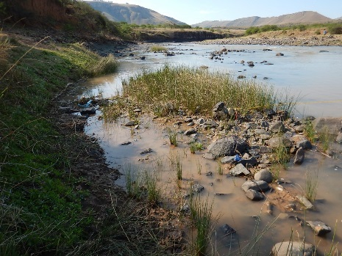
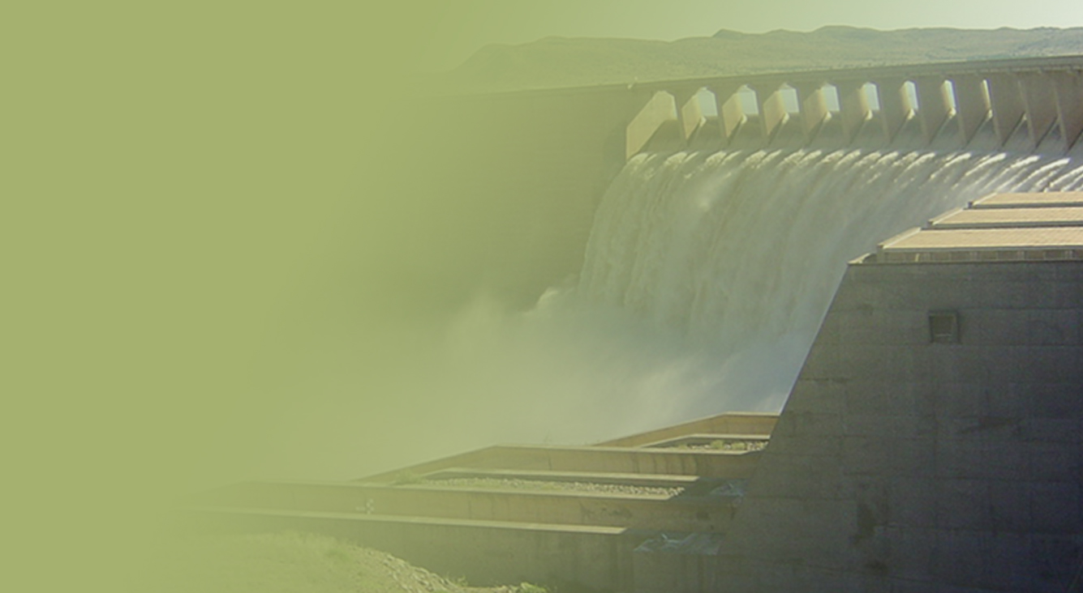
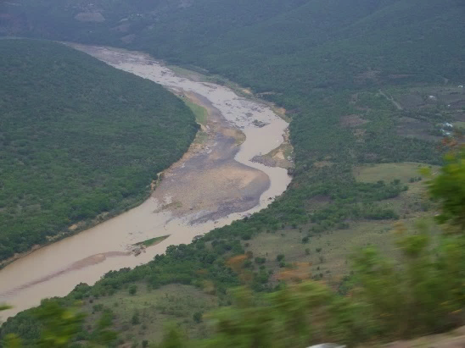
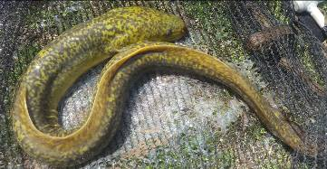
DETERMINATION OF WATER RESOURCE CLASSES AND RESOURCE QUALITY OBJECTIVES FOR THE WATER RESOURCES IN THE MZIMVUBU CATCHMENT
Defining System Operating Rules
Training, 31 May
PRESENTATION TITLE
Presented by:
Name Surname
Directorate
Date
Colin Talanda

Slide 2
Contents
1. Background
2. Creating a representative Network
3. Using “penalties” to define
operating rules

Slide 3
1. Background

Slide 4
General
Operation of system must be controlled
Generally based on:
  Practical experience
  Specialist analysis
Overall objectives:
  Optimise utilisation of water resource
  Minimise cost of operation

Slide 5
Typical aspects
Prioritisation of supply to water users
Prioritisation of use of water sources
Conditions under which inter-reservoir and inter-basin support occurs (i.e. Ntabaleng & Laleni)
EWR Requirements (i.e Laleni Hydropower operation)
Minimisation of spillage
Blending options
Flood management

Slide 6
Selection process
Define objectives (scenario matrix)
Select initial set of operating rules
Implement initial selection in model
Undertake analysis and interpret results
Evaluate achievement of objectives
Reselect operating rules
Repeat selection process

Slide 7
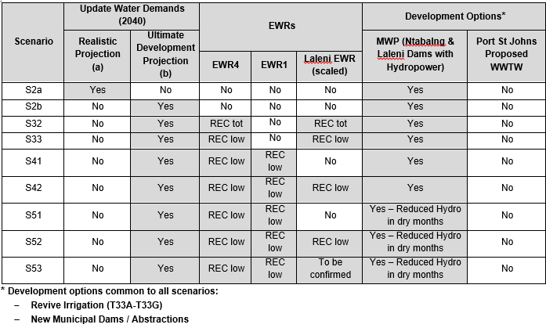
Selection process

Slide 8
2. Creating a representative network model

Slide 9
Identify main physical features
Water source
Water users
Runoff
River
Recreation
Urban
Reservoir
Irrigation
Industrial
Ecology

Slide 10
Representative model symbols
= Reservoir
= Runoff
= Flow route (with sink )
= Junction node
= Water user
X
X
X
X

Slide 11
Resulting network model
Urban
1
4
Recreation
Ecology
2
3
4
1
3
5
7
2
6
Irrigation
Industrial

Slide 12
Demands/Water Use
Urban/Industrial: 12 monthly values (monthly distribution)
Irrigation: Irrigation blocks i.e. Allocation, irrigation efficiency, return flow, soil characteristics, effective rainfall factors, evaporation, crop types/crop factors, irrigation area

Slide 13
Demands/Water Use
Afforestation and Alien Invasive: Time series from Hydrological Analysis
Ecological Water Requirements (EWRs): Range of monthly runoff reference flows & Real Monthly IFR flows (corresponding to reference flows)
(show file from Drew)

Slide 14
3. Using “penalties” to
define operating rules

Slide 15
Penalties
Tool for implementing selected operating rules in model
Dimensionless value assigned by analyst to system components:
  Channels: for every unit of flow
  Reservoirs: for every unit of water in storage
Interpreted by comparing relative size
Basis of model flow-routing solution

Slide 16
Penalty selection (1 of 3)
P = 1
2 m³/s P = 5
User
Flow = 2 m³/s
Flow
P = 10
2 m³/s P = 5
User
Flow = 0 m³/s
Flow
P = 10
2 m³/s P = 11
User
Flow = 2 m³/s
Flow

Slide 17
Penalty selection (2 of 3)
2 m³/s P = 5
P = 1
User 1
Flow 1
Flow 1 = 2 m³/s
Flow 2 = 2 m³/s
2 m³/s P = 15
User 2
Flow 2
2 m³/s P = 5
P = 10
User 1
Flow 1
Flow 1 = 0 m³/s
Flow 2 = 2 m³/s
2 m³/s P = 15
User 2
Flow 2
2 m³/s P = 5
P = 20
User 1
Flow 1 = 0 m³/s
Flow 2 = 0 m³/s
Flow 1
2 m³/s P = 15
User 2
Flow 2

Slide 18
Penalty selection (3 of 3)
P = 10
A
2 m³/s P = 5
User
Flow 1
Flow 3
Flow 1 = 0 m³/s
Flow 2 = 2 m³/s
Flow 3 = 2 m³/s
P = 1
B
Flow 2
P = 1
A
2 m³/s P = 5
User
Flow 1
Flow 3
Flow 1 = 2 m³/s
Flow 2 = 0 m³/s
Flow 3 = 2 m³/s
P = 10
B
Flow 2

Slide 19
Water resource system
Runoff
30 m³/s (Pri. 8)
10 m³/s
1 m³/s
0.5 m³/s
(Pri. 5)
(Pri. 4)
(Pri. 1)
Recreation
11.5
Urban
Reservoir
1 m³/s (Pri. 2)
Ecology
20 m³/s
1 m³/s
(Pri. 7)
(Pri. 6)
21.0
Irrigation
Industrial
4 m³/s (Pri. 3)

Slide 20
Network model with penalties
10 m³/s
1 m³/s
0.5 m³/s
P = 20
P = 200
P = 1200
P = 1
P = 10
P = 100
P = 400
P = 1000
11.5
Urban
4
30 m³/s P = 2
1 m³/s P = 750
1
Recreation
Ecology
2
3
4
1
3
5
7
2
6
Irrigation
Industrial
20 m³/s
1 m³/s
P = 5
P = 15
4 m³/s P = 500
21.0

Slide 21
Case 1: Reservoir in Zone 1
10 m³/s
1 m³/s
0.5 m³/s
P = 20
P = 200
P = 1200
P = 1
P = 10
P = 100
P = 400
P = 1000
Water level
11.5
Urban
11.5
4
30 m³/s P = 2
1 m³/s P = 750
1
Recreation
Ecology
2
3
4
1
3
5
7
37.5
16.5
5.0
1.0
21.0
2
4.0
6
Irrigation
Industrial
20 m³/s
1 m³/s
P = 5
P = 15
4 m³/s P = 500
21.0
= channel flow in m³/s
16.5

Slide 22
Case 2: Reservoir in Zone 10
10 m³/s
1 m³/s
0.5 m³/s
P = 20
P = 200
P = 1200
P = 1
P = 10
P = 100
P = 400
P = 1000
11.5
Water level
Urban
11.5
4
30 m³/s P = 2
1 m³/s P = 750
1
Recreation
Ecology
2
3
4
1
3
5
7
17.5
16.5
5.0
1.0
1.0
2
4.0
6
Irrigation
Industrial
20 m³/s
1 m³/s
P = 5
P = 15
4 m³/s P = 500
21.0
= channel flow in m³/s
16.5

Slide 23
Case 3: Reservoir in Zone 100
10 m³/s
1 m³/s
0.5 m³/s
P = 20
P = 200
P = 1200
P = 1
P = 10
P = 100
P = 400
P = 1000
1.5
Water level
Urban
1.5
4
30 m³/s P = 2
1 m³/s P = 750
1
Recreation
Ecology
2
3
4
1
3
5
7
6.5
6.5
5.0
1.0
0.0
2
4.0
6
Irrigation
Industrial
20 m³/s
1 m³/s
P = 5
P = 15
4 m³/s P = 500
21.0
= channel flow in m³/s
16.5

Slide 24
Case 4: Reservoir in Zone 400
10 m³/s
1 m³/s
0.5 m³/s
P = 20
P = 200
P = 1200
P = 1
P = 10
P = 100
P = 400
P = 1000
0.5
Urban
Water level
0.5
4
30 m³/s P = 2
1 m³/s P = 750
Recreation
Ecology
1
2
3
4
1
3
5
7
5.5
5.5
5.0
1.0
0.0
2
4.0
6
Irrigation
Industrial
20 m³/s
1 m³/s
P = 5
P = 15
4 m³/s P = 500
21.0
= channel flow in m³/s
16.5

Slide 25
Case 5: Reservoir in Zone 1000
10 m³/s
1 m³/s
0.5 m³/s
P = 20
P = 200
P = 1200
P = 1
P = 10
P = 100
P = 400
P = 1000
0.5
Urban
Water level
0.5
4
30 m³/s P = 2
1 m³/s P = 750
Recreation
Ecology
1
2
3
4
1
3
5
7
0.5
0.5
0.0
0.0
0.0
2
0.0
6
Irrigation
Industrial
20 m³/s
1 m³/s
P = 5
P = 15
4 m³/s P = 500
21.0
= channel flow in m³/s
16.5

Slide 26
Modelling channel penalties
Basic building blocks: “arcs”
Allow particular flows under specific
circumstances
For each arc, 3 data values defined:
  Lower flow limit
  Upper flow limit
  Penalty (“dis-benefit” of every unit of flow)
Up to 5 arcs, generally only 1 or 2

Slide 27
1-arc channel
Configuration
Flow = 0 to X;
Penalty = P
Arc
U/s
node
D/s
node
Standard notation
0 to X
P

Slide 28
2-arc channel (1 of 2)
Configuration
Flow = X to Y (usually Y = X);
Penalty = 0 (usually)
Arc 1
U/s
node
D/s
node
Arc 2
Flow = 0 to X;
Penalty = P
Standard notation
X to Y
0
0 to X
P

Slide 29
2-arc channel (2 of 2)
Urban
1
Recreation
Ecology
2
3
4
6
Irrigation
Industrial
4 m³/s P = 500
6
4 to 4
0
0 to 4
500

Slide 30
Modelling reservoir penalties
Defined in terms of “storage zones” and
“rule curve level”
For each zone, 2 data values defined:
  Elevation of lower zone boundary
  Zone penalty
Penalty relation to rule curve:
  Above: “dis-benefit” of water in storage
  Below: “benefit” of water in storage

Slide 31
Standard reservoir notation
P₁ (-1 000)
FSL
Rule curve level
P₂ (10)
Zone level
P₃ (50)
DSL
P₄ (10 000)
Bottom

Slide 32
Example: Heyshope-Grootdraai transfer (2 of 2)
Spill
Compensation
53
54
0 to inf.
20
53
54
0.64 to 0.64
0
0 to 0.64
250
35
Heyshope Dam
35
1303.00 (FSL)
10
52
52
0 to 5.0
2
1287.00 (DSL)
34
33
1548.96 (FSL)
2
1547.99 (90 %)
20
50
1533.00 (DSL)
33
50
0 to inf.
0
Grootdraai
Dam
45
45
YIELD
TD to TD
0
46
0 to TD
200
0 to Inf.
10
46
47
47
Spill
Compensation
0.13 to 0.13
0
0 to 0.13
250

Slide 33
4. Practical 2: Interpreting penalties

Slide 34
Purpose and methodology
Purpose:
Explore use of penalties to model operating rules
Investigate behaviour of system under various situations
Methodology:
Analyse system for 3 cases
Complete table with results

Slide 35
Physical system
Natural runoff
Reservoir B
Natural runoff
Reservoir B
Transfer
Ecology
Reservoir A
Urban
Ecology
Irrigation

Slide 36
Network model with penalties
B
Ecology
B
7
20
2.0 to 2.0
0
0 to 2.0
50
Urban
0 – 2
5
6
1.0 to 1.0
0
4
0 to 1.0
50
A
Ecology
2
3
A
1
3
5
1
2.0 to 2.0
0
10
0 to 2.0
30
10 to 10
0
2
0 to 10
5
Irrigation

Slide 37
Case 1: Reservoir A in Zone 1
B
Ecology
B
7
20
2.0 to 2.0
0
0 to 2.0
50
Urban
0 – 2
5
6
1.0 to 1.0
0
4
0 to 1.0
50
A
Ecology
2
3
A
1
3
5
1
2.0 to 2.0
0
10
0 to 2.0
30
10 to 10
0
2
0 to 10
5
Irrigation

Slide 38
Case 2: Reservoir A in Zone 10
B
Ecology
B
7
20
2.0 to 2.0
0
0 to 2.0
50
Urban
0 – 2
5
6
1.0 to 1.0
0
4
0 to 1.0
50
A
Ecology
2
3
A
1
3
5
1
2.0 to 2.0
0
10
0 to 2.0
30
10 to 10
0
2
0 to 10
5
Irrigation

Slide 39
Case 3: Reservoir A fails
B
Ecology
B
7
20
2.0 to 2.0
0
0 to 2.0
50
Urban
0 – 2
5
6
1.0 to 1.0
0
4
0 to 1.0
50
A
Ecology
2
3
A
1
3
5
1
2.0 to 2.0
0
10
0 to 2.0
30
10 to 10
0
2
0 to 10
5
Irrigation

Slide 40
Table to be completed:
Channel
Flow in channels for indicated cases
Case 1: Reservoir A in zone 1
Channel No.
Flow (m³/s)
Case 2: Reservoir A in zone 10
Channel No.
Flow (m³/s)
Case 3: Reservoir A failure
Channel No.
Flow (m³/s)
1
1
1
2
2
2
3
3
3
4
4
4
5
5
5
6
6
6
7
7
7

Slide 41
Results

Slide 42
Completed table:
Channel
Flow in channels for indicated cases
Case 1: Reservoir A in zone 1
Channel No.
Flow (m³/s)
Case 2: Reservoir A in zone 10
Channel No.
Flow (m³/s)
Case 3: Reservoir A failure
Channel No.
Flow (m³/s)
1
13
1
3
1
2
2
10
2
0
2
0
3
3
3
3
3
2
4
1
4
1
4
1
5
2
5
2
5
1
6
0
6
0
6
2
7
2
7
2
7
2

Slide 43

DWS TRAINING
End

